Slide 1
LEARNING PYTHON
20221005

Slide 2
AGENDA
1
PYTHON STRINGS
5
FORMAT STRINGS
2
SLICING STRINGS
6
ESCAPE STRINGS
3
MODIFY STRINGS
7
STRING METHODS
4
CONCATENATE STRINGS

Slide 3
PYTHON STRINGS
20221005

Slide 4
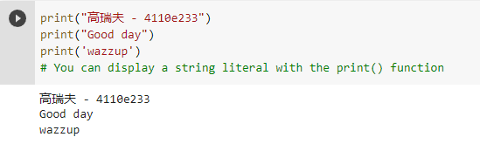
Strings
Strings in python are surrounded by either single quotation marks, or double quotation marks.

Slide 5
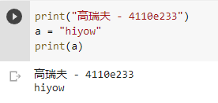
Assign String to a Variable
Assigning a string to a variable is done with the variable name followed by an equal sign and the string.

Slide 6
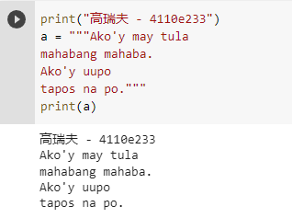
Multiline Strings
You can assign a multiline string to a variable by using three quotes

Slide 7
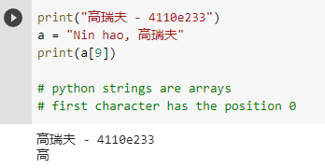
Strings are Arrays
Strings in Python are arrays of bytes representing unicode characters.
Python does not have a character data type, a single character is simply a string with a length of 1.
Square brackets can be used to access elements of the string.

Slide 8
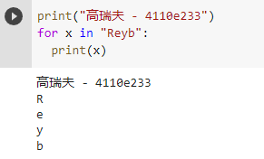
Looping Through a String
Since strings are arrays, we can loop through the characters in a string, with a for loop.

Slide 9
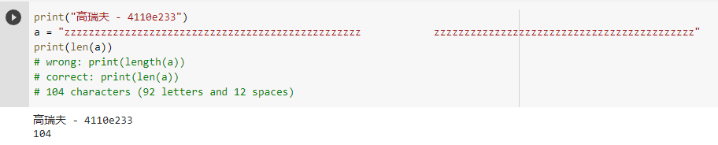
String Length
To get the length of a string, use the len() function.

Slide 10
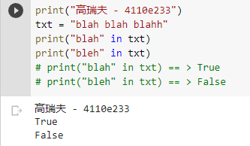
Check String
To check if a certain phrase or character is present in a string, we can use the keyword in.
keyword in vs if
True or False

Slide 11
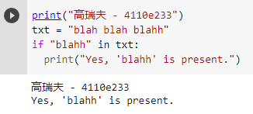
Check String
Use it in an if statement:

Slide 12
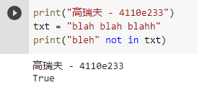
Check if NOT
To check if a certain phrase or character is NOT present in a string, we can use the keyword not in.

Slide 13
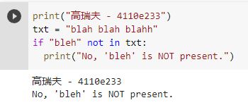
Check if NOT
Use it in an if statement:

Slide 14
SLICING STRINGS
20221005

Slide 15
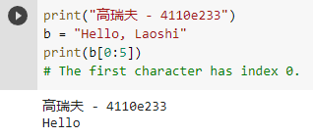
Slicing
Return a range of characters by using the slice syntax.
Specify the start index and the end index, separated by a colon, to return a part of the string.

Slide 16
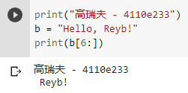
Slice To the End
By leaving out the end index, the range will go to the end.

Slide 17
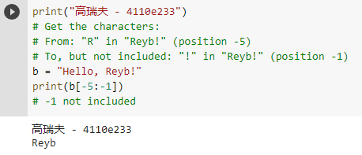
Negative Indexing
Use negative indexes to start the slice from the end of the string.

Slide 18
MODIFY STRINGS
20221005

Slide 19
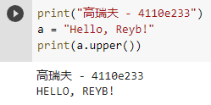
Upper Case
The upper() method returns the string in upper case

Slide 20
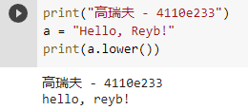
Lower Case
The lower() method returns the string in lower case

Slide 21
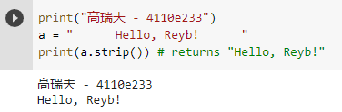
Remove Whitespace
Whitespace is the space before and/or after the actual text, and very often you want to remove this space.
The strip() method removes any whitespace from the beginning or the end

Slide 22
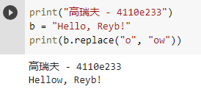
Replace String
The replace() method replaces a string with another string

Slide 23
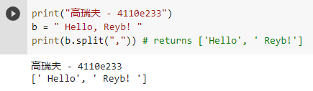
Split String
The split() method returns a list where the text between the specified separator becomes the list items.

Slide 24
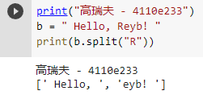
Split String
The split() method splits the string into substrings if it finds instances of the separator

Slide 25
CONCATENATE STRINGS
20221005

Slide 26
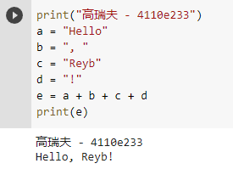
String Concatenation
To concatenate, or combine, two strings you can use the + operator.

Slide 27
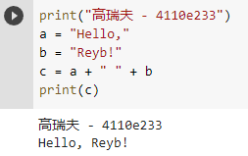
String Concatenation
To add a space between them, add a " "

Slide 28
FORMAT STRINGS
20221005

Slide 29
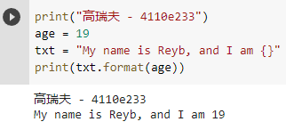
String Format
The format() method takes the passed arguments, formats them, and places them in the string where the placeholders {} are

Slide 30
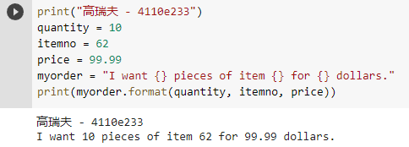
String Format
The format() method takes unlimited number of arguments, and are placed into the respective placeholders

Slide 31
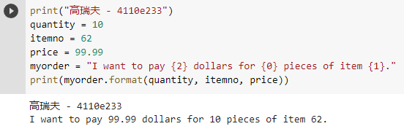
String Format
You can use index numbers {0} to be sure the arguments are placed in the correct placeholders

Slide 32
ESCAPE CHARACTERS
20221005

Slide 33
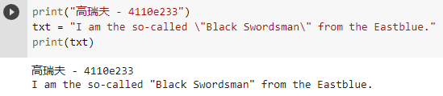
Escape Character
To insert characters that are illegal in a string, use an escape character.
An escape character is a backslash \ followed by the character you want to insert.

Slide 34
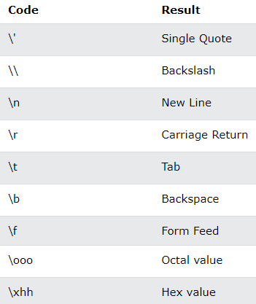
Escape Characters
Other escape characters used in Python:

Slide 35
STRING METHODS
20221005

Slide 36
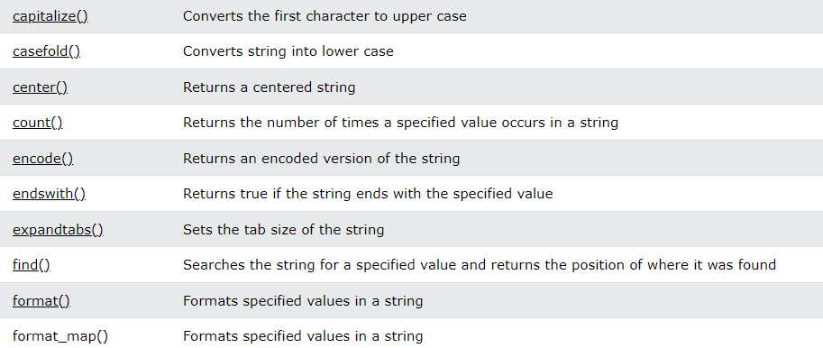
String Methods
All string methods return new values. They do not change the original string.

Slide 37
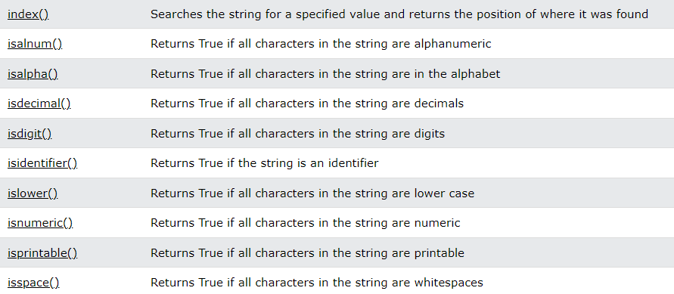
String Methods

Slide 38
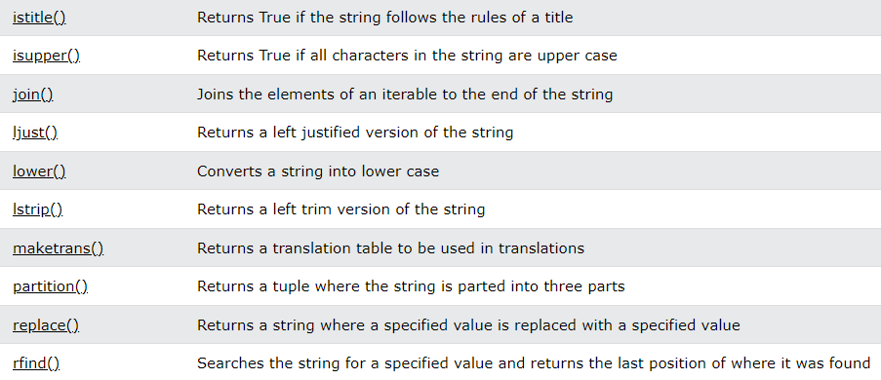
String Methods

Slide 39
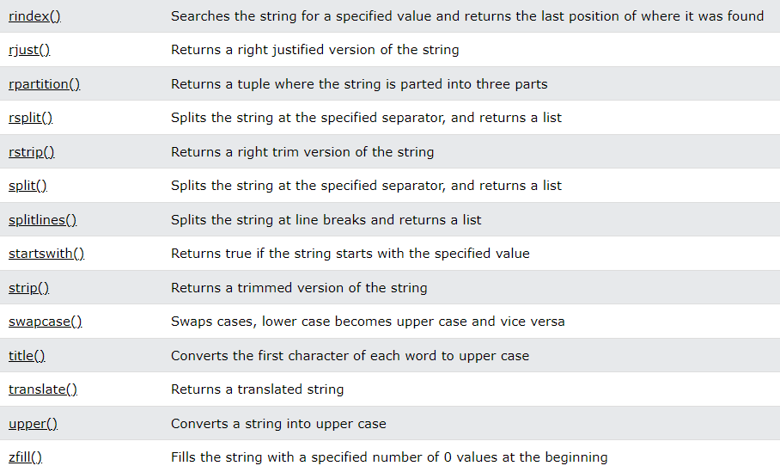

Slide 40
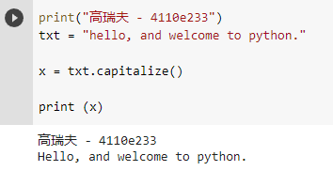
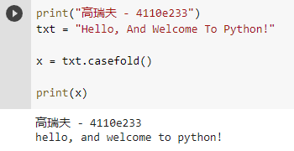
String Methods

Slide 41
Thanks

